Slide 1
North Country Children’s Museum
Clarkson University | Spring 2024

Slide 2
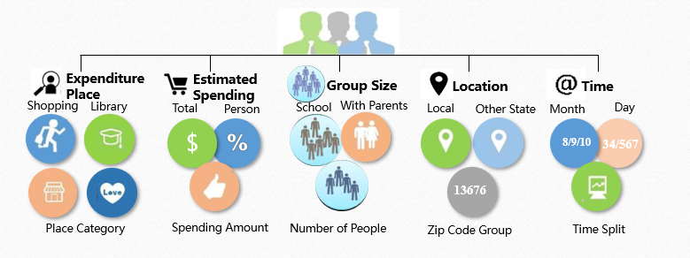
1. Data Collection

Slide 3
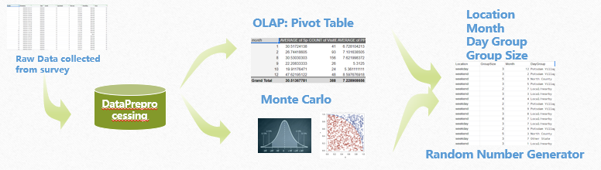
2. Data Simulation
We conducted a preliminary analysis, during which we formed pivot tables and performed calculations based on cumulative location, spending probability, impact probability, and economic impact. We then used Monte Carlo simulations to model these calculations, based on an average of 22,000 visitors.
The data included detailed visitor information such as VisitID, Timestamp, Date, Zip Code, Zip Groups, group size, relationship to children, and planned spending at other businesses in Potsdam. This comprehensive approach allowed us to estimate the potential economic impact on local businesses effectively.

Slide 4
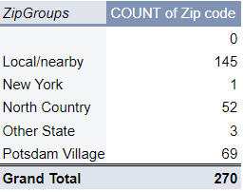
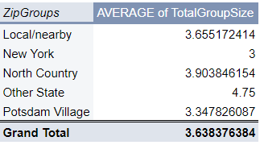
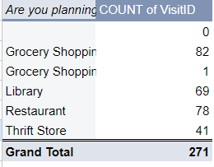
3. Descriptive statistic from survey

Slide 5
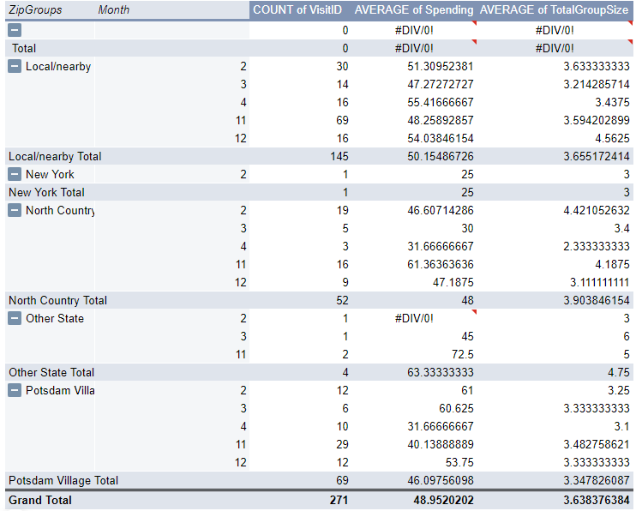
4. Averaging of spending of total group size

Slide 6
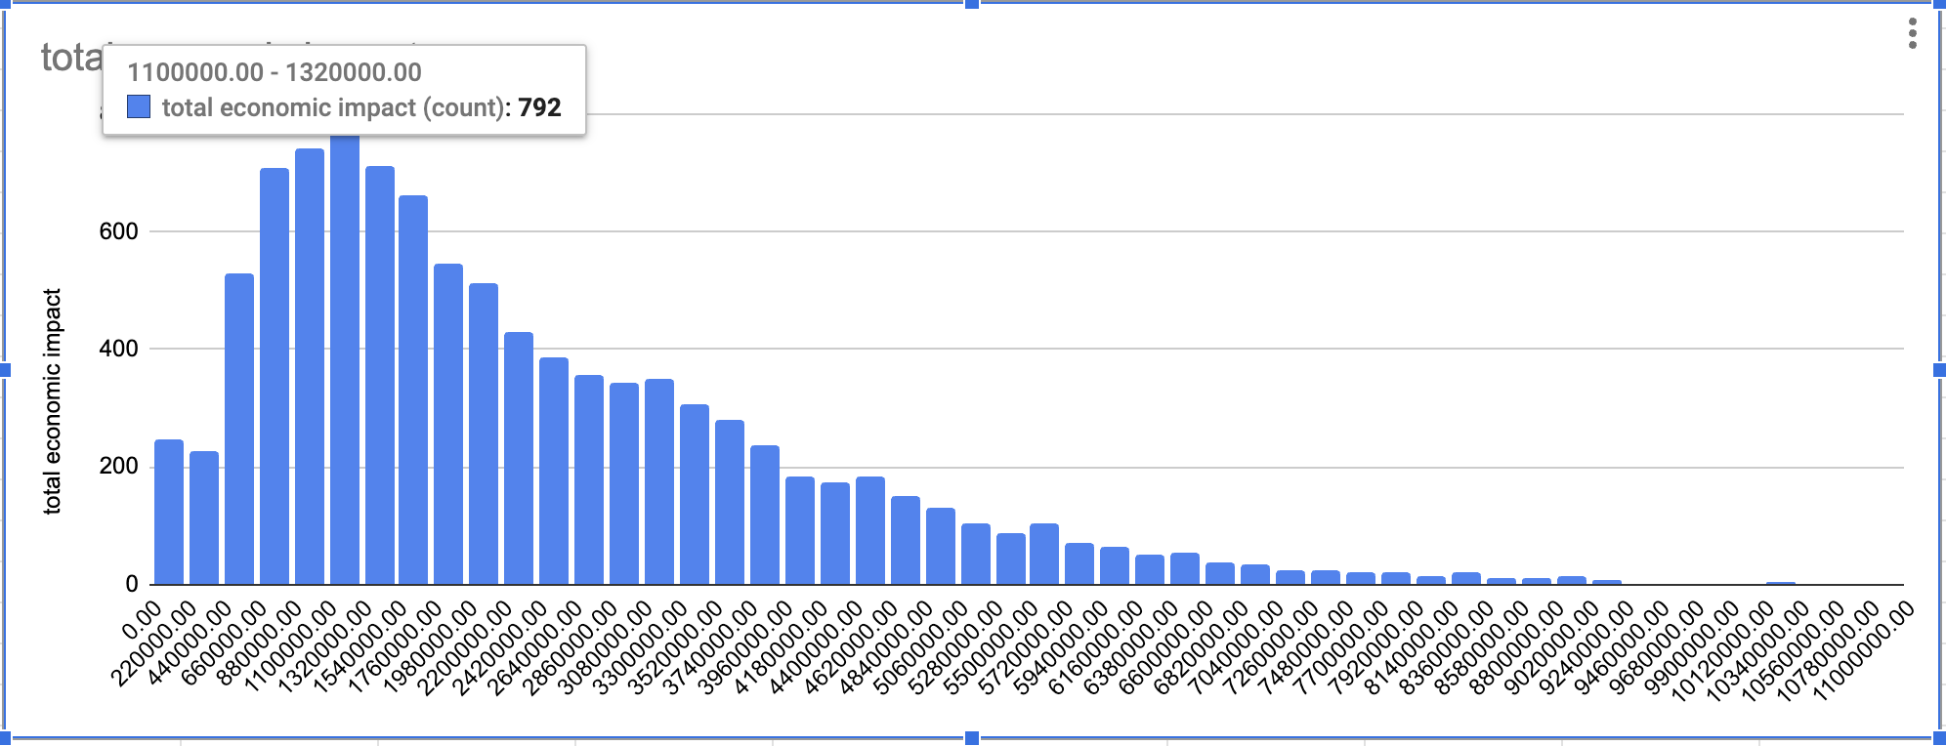
5. NCCM total contribution
Estimated Revenue Generation in 2019: $655000
Estimated Revenue Generation in 2024: $1.1 Million to $1.32 Million

